Slide 1
Lecture 35
Memory management - Paging
National University of
Computer & Emerging Sciences

Slide 2
Paging
Most virtual memory systems use Paging
Idea: logical address space of a process can be made noncontiguous; process is allocated physical memory whenever the latter is available.

Slide 3
Paging
Partition memory into small equal fixed-size chunks and divide each process into the same size chunks
  The chunks of a process are called pages
  The chunks of memory are called frames

Slide 4

Paging Example

Slide 5
Paging
If the Program generates the Virtual Address of a page that is unmapped
  Present/Absent bit = 0
MMU generates an Interrupt called Page Fault
This invokes the Operating System
  OS swaps out one of the Page from RAM
  Swaps in the required page
  Updates the Page Table

Slide 6
Addresses
CPU generates address for
  Fetching/Storing Variables
  Fetching Instructions
  Jumping to labels (in case of loops)
  etc
Each address generated by CPU now requires two memory references
  1. To access the Page Table
  2. To access the actual address of the instruction/variable/label

Slide 7
Address resolution
A program generates Virtual addresses of Virtual Address Space
Which are then mapped to Physical addresses of Physical Address Space
In VM Virtual Address Space can be larger than Physical Address Space

Slide 8
Address generated by CPU is divided into:
  Page number (p) – used as an index into a page table which contains base address of each page in physical memory
  Page offset (d) – combined with base address to define the physical memory address that is sent to the memory unit

Slide 9
CPU
Virtual Address
Physical Address
p
d
f
d
f0000
.
0
f1111
p
f
Physical Memory
Page Table
MMU

Slide 10
Addresses mapping
Page size is normally chosen to be a power of 2, why?
It makes things easier !!

Slide 11
Address Translation Scheme
For given logical address space 2^{m} and page size 2^{n}
page number
page offset
p
d
m - n
n
Size of logical address space = 2^{m} = # of pages × page size

Slide 12
Address Translation Scheme
Size of logical address space = 2^{m} = # of pages × page size = 16 X 4096
  2^{m} = 2⁴ X 2^{12?}
  2^{m} = 2¹⁶
  m = 16
page number
page offset
p
d
m - n
n

Slide 13
Address Translation Scheme
page size = 2^{n}
2^{n} = 4096 = 2¹²
n = 12
page number
page offset
p
d
m - n
n

Slide 14
Address Translation Scheme
page number
page offset
p
d
m - n
n
8196 = 0010000000000100
  m=16, n=12
  Page number = m-n bits = First 4 bits
  Page offset = n bits = Last 12 bits
  4 bit page number can represent 16 pages
  12 bit offset can address all 4096 bytes within a page !!

Slide 15
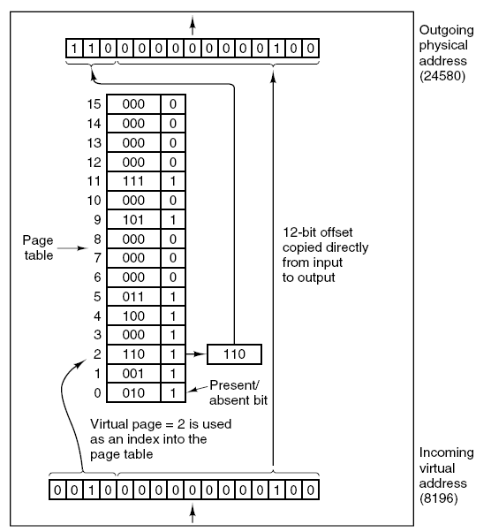

Slide 16
00000
00001
00010
00011
00100
00101
00110
00111
01000
01001
01010
01011
01100
01101
01110
01111
10000
10001
10010
10011
10100
10101
10110
10111
11000
11001
11010
11011
11100
11101
11110
11111
Virtual Address Space Size = 32 B
Physical Address Space
00000
00001
00010
00011
00100
00101
00110
00111
01000
01001
01010
01011
01100
01101
01110
01111
10000
10001
10010
10011
10100
10101
10110
10111
11000
11001
11010
11011
11100
11101
11110
11111
000
000
Page Size = 4 B
001
# of Pages?
32/4 = 8
001
010
First 3 Bits represent the Virtual Page Number
First 3 Bits represent the Physical Page Number
010
011
011
000
111
Last 2 Bits represent the Page Offset
Last 2 Bits represent the Page Offset
001
010
100
010
000
100
011
011
101
100
101
101
101
110
110
100
110
110
111
001
Page Table
111
111

Slide 17
00000
00001
00010
00011
00100
00101
00110
00111
01000
01001
01010
01011
01100
01101
01110
01111
10000
10001
10010
10011
10100
10101
10110
10111
11000
11001
11010
11011
11100
11101
11110
11111
Virtual Address Space
Physical Address Space
00000
00001
00010
00011
00100
00101
00110
00111
01000
01001
01010
01011
01100
01101
01110
01111
10000
10001
10010
10011
10100
10101
10110
10111
11000
11001
11010
11011
11100
11101
11110
11111
000
000
CPU
001
001
Add x,y,z
11101
00101
.
010
010
011
011
000
111
001
010
100
010
000
100
011
011
101
100
101
101
101
110
110
100
110
110
111
001
Add x,y,z
Page Table
111
111

Slide 18
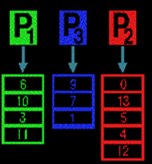
Where is the Page Table Stored?
Page Table Base Register
(PTBR)
Points to the Page Table of Running Process
Operating System

Slide 19
Paging
Operating system maintains a page table for each process
  Contains the frame location for each page in the process
  Memory address consist of a page number and offset within the page

Slide 20
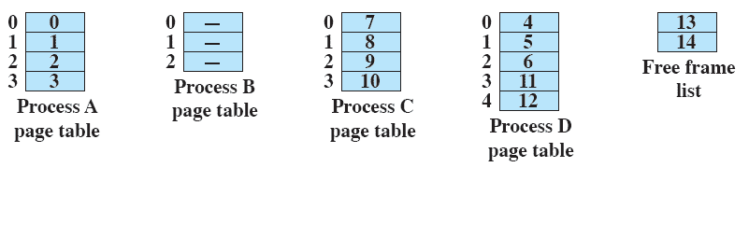
Page Table

Slide 21
Page Table
The only hardware required is a register
Points to the starting address of the Page table
Whenever, there is a context switch
The register points to the starting address of the new process’s page table

Slide 22
Memory Protection
Memory protection implemented by associating
protection bit with each frame
Valid-invalid bit attached to each entry in the page table:
  “valid” indicates that the associated page is in the process’ logical address space, and is thus a legal page
  “invalid” indicates that the page is not in the process’ logical address space

Slide 23
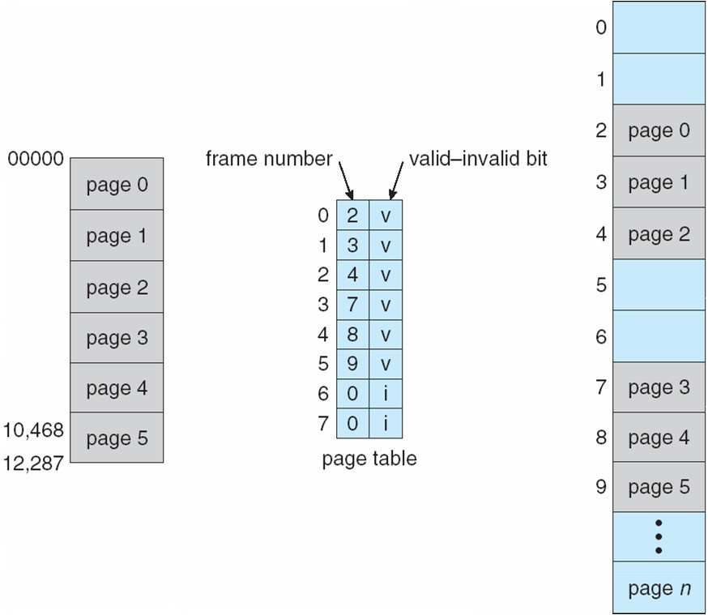
Valid (v) or Invalid (i) Bit In A Page Table
8

Slide 24
Page Table
Two major issues are:
  The Page table entries can be extremely large
  The mapping must be fast

Slide 25
Page Table Size
If we have
  32-bit addresses
  Page size = 4 KB = 2¹² B
  Possible Pages??
  2³²/2¹²
  = 2²⁰
  = 10⁶
  = 1 Million
➔ We need 1 Million Page Table entries in RAM all the Time!!!

Slide 26
Page Table Size
Increasing the Page size will decrease the number of pages
…but…
More Internal Fragmentation

Slide 27
RAM Vs. Registers
Remember:
  If referring to RAM is like walking
  Then referring a Register is like flying an aero plane

Slide 28
Solution
Keep a number of fast hardware registers
When a process starts
OS loads the registers with the Process’s entire Page table
Process’s Page table is available in RAM
During execution no memory references are required for Page tables
But is expensive, if page size is large

Slide 29
Translation Look-aside Buffer (TLB)
A better solution is TLB:
  A special, small, fast-lookup Hardware cache
The TLB contains a few Page-Table entries
Whenever, a virtual address is generated:
  The page number is presented to the TLB
  If the entry is found
    Its used to access memory
  Else (TLB miss)
    The actual Page table stored in RAM is used
We may would like to add this Page Table entry into TLB

Slide 30
Hit Ratio
Percentage of times a particular page is found in the TLB
20 ns to Search TLB
100 ns to Access Memory
➔ 120 ns to Access Memory when the Entry is in the TLB
➔ 220 ns to Access Memory when the Entry is not in the TLB
If Hit-Ratio = 80%
  Effective access time = 0.80 * 120 + 0.20 * 220 = 140 ns
If Hit-Ratio = 98%
  Effective access time = 0.98 * 120 + 0.02 * 220 = 122 ns

Slide 31
Translation Look-aside Buffer (TLB)
All entries in TLB may correspond to a single process
  The currently running process
  TLB must be erased/flushed on every context switch
Or it may have entries from multiple processes
  We need to distinguish between the Page Table entries from multiple processes
  So, each entry in TLB will also have a Process Identifier

Slide 32
Example
An 80-percent hit ratio means that we can find the desired page number in the TLB 80 percent of the time.
If it takes 20 nanoseconds to search the TLB and 100 nanoseconds to access memory, then a mapped memory access takes 120 nanoseconds when the page number is in
TLB.
We fail to find the page number in the TLB, we must first
access memory for the page table and frame number (100 nanoseconds) and then access the desired byte in memory (100 nanoseconds) for a total 220 nanoseconds.
Effective Access Time (EAT)
EAT = (1 + ε) α + (2 + ε)(1 – α)
= 2 + ε – α
Effective Access Time (EAT) = 0.8 * 120 + 0.2 * 220 = 140 What is the effective access time, if hit ratio is 98%?

Slide 33
Structure of the Page Table
Hierarchical Paging
Hashed Page Tables
Inverted Page Tables

Slide 34
Hierarchical Page Tables
Break up the logical address space into multiple page tables
A simple technique is a two-level page table

Slide 35
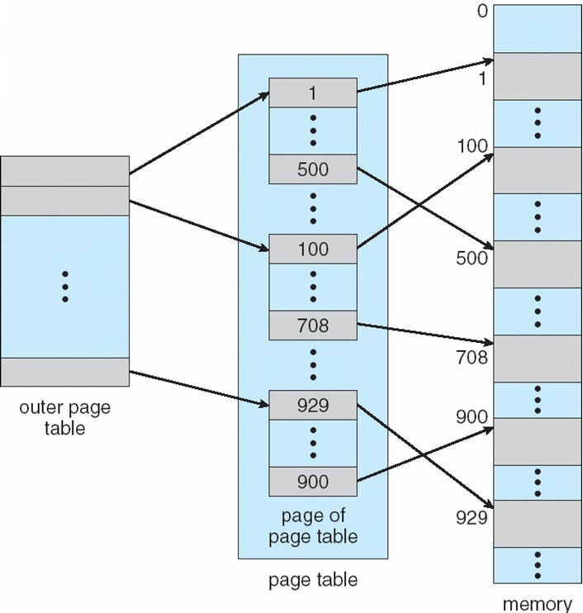
Two-Level Page-Table Scheme

Slide 36
Two-Level Paging Example
A logical address (on 32-bit machine with 1K page size) is divided into:
  a page number consisting of 22 bits
  a page offset consisting of 10 bits
Since the page table is paged, the page number is further divided into:
  a 12-bit page number
  a 10-bit page offset
Thus, a logical address is as follows:
p
age number |  | page offset
p_{i} | p₂ | d
12
10
10
where p_{i} is an index into the outer page table, and p₂ is the displacement within the page of the outer page table

Slide 37

Address-Translation Scheme

Slide 38
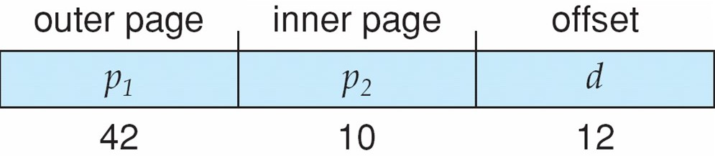
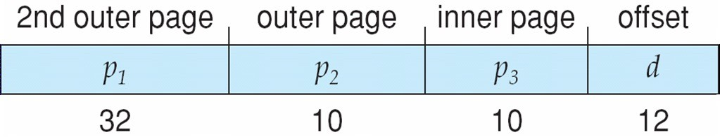
Three-level Paging Scheme

Slide 39
Hashed Page Tables
Common in address spaces > 32 bits
The virtual page number is hashed into a page table
  This page table contains a chain of elements hashing to the same location
Virtual page numbers are compared in this chain searching for a match
  If a match is found, the corresponding physical frame is extracted
Operating System Concepts with Java – 8th Edition
8.<number>
Silberschatz, Galvin and Gagne ©2009

Slide 40

Hashed Page Table

Slide 41
Inverted Page Table
One entry for each real page of memory
Entry consists of the virtual address of the page stored in that real memory location, with information about the process that owns that page
Decreases memory needed to store each page table, but increases time needed to search the table when a page reference occurs
Use hash table to limit the search to one — or at most a few — page-table entries
Operating System Concepts with Java – 8th Edition
8.<number>
Silberschatz, Galvin and Gagne ©2009

Slide 42

Inverted Page Table Architecture

Slide 43
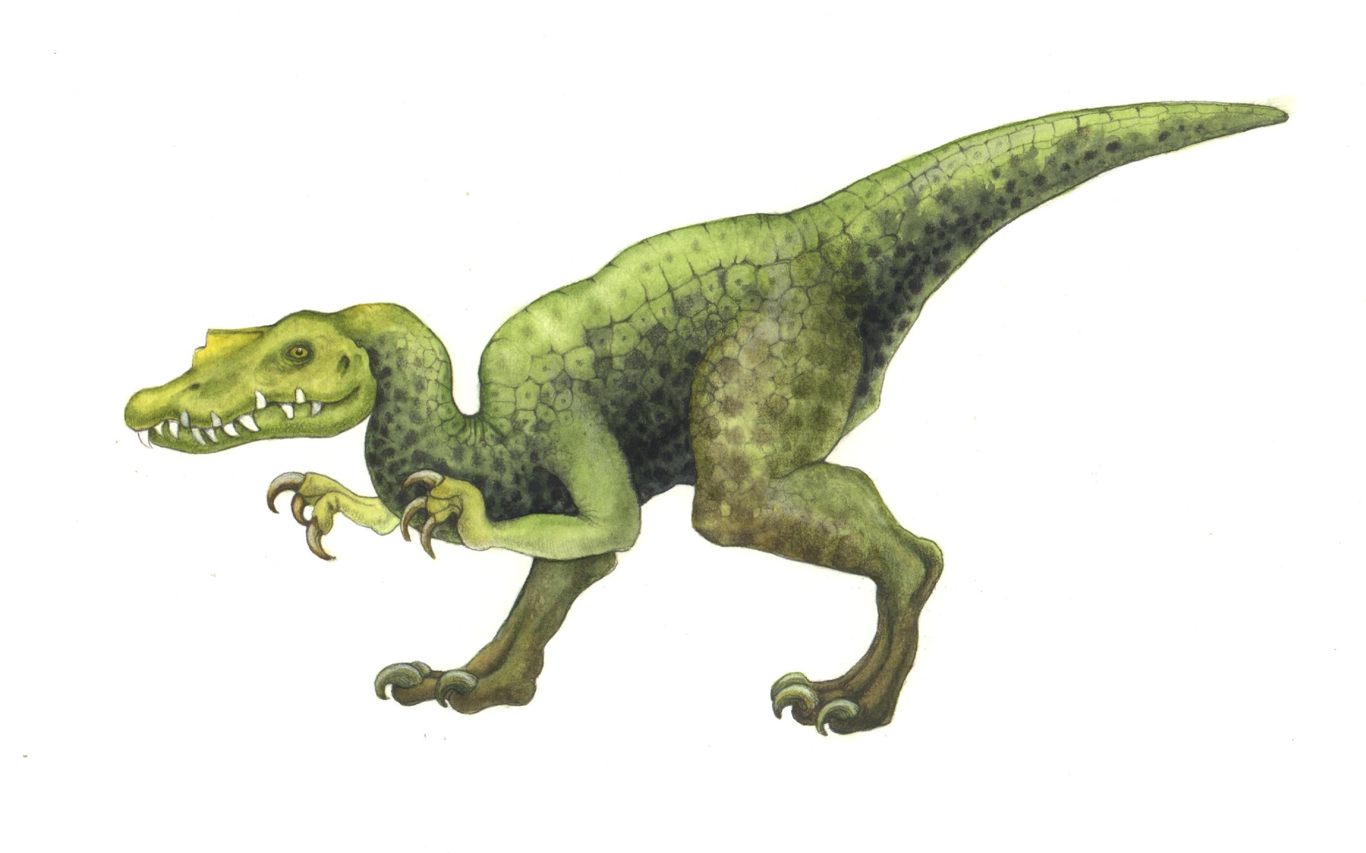
End of Chapter 8
Operating System Concepts with Java – 8th Edition
8.<number>
Silberschatz, Galvin and Gagne ©2009

